Slide 1

P4-DVPF Dynamic Verification of Packets Forwarding Based on P4 for SDN
CIS 537 - Advanced Networking Final Project Winter 2026
Replication of a Programmable Data Plane Security Framework for SDN
Hasan Alabudi Section 2

Slide 2
P4-DVPF Final Project
Introduction:
This project replicates the P4-DVPF framework (mentioned in the article), which moves attack detection from the SDN controller into the programmable data plane using P4. I implemented a simplified version using BMv2 and evaluated it with normal and abnormal traffic.
The original paper uses machine learning techniques such as Random Forest for classification. However, in this implementation, I approximated the detection using threshold-based logic due to limitations of P4 targets and to simplify real-time processing in the data plane

Slide 3
Paper Focus
The article focuses on the three main objectives:
P4-DVPF Framework
Detects attacks directly in the data plane using P4
Reduces controller dependency

Slide 4
Main Contribution
Moved detection from controller to switch
In traditional SDN, packets must be sent to the controller for analysis, which introduces delay and overhead. In this work, detection logic is implemented directly inside the P4 switch (data plane), allowing the switch itself to analyze packet behavior and make decisions without relying on the controller.
Real-time attack detection
Because detection is performed inside the switch pipeline, every packet is analyzed as it is processed. This enables immediate identification of abnormal traffic patterns or tampered packets, allowing the system to detect attacks instantly as they occur.
Lower latency
Eliminating the need to send packets to the controller significantly reduces processing delay. Since decisions are made locally within the switch, packets are either forwarded or dropped without additional communication, resulting in faster response times and improved network performance.

Slide 5
Attack Types
1. New Stream Attack (traffic flooding)
2. Hijacking Attack (packet modification)

Slide 6
Implementation & Detection Mechanism
New Stream: traffic imbalance detection
Monitor destination distribution using counters.
Detect dominance of a single flow or destination.
Use a threshold to flag abnormal behavior.
The threshold is a predefined value that determines when traffic behavior is considered abnormal (attack) instead of normal.
Indicates flooding or abnormal traffic patterns.
Hijacking: metadata vs packet comparison
Store original destination in metadata.
Compare metadata with current packet fields.
Detect any modification or mismatch.
Indicates packet tampering or a redirection attack.

Slide 7
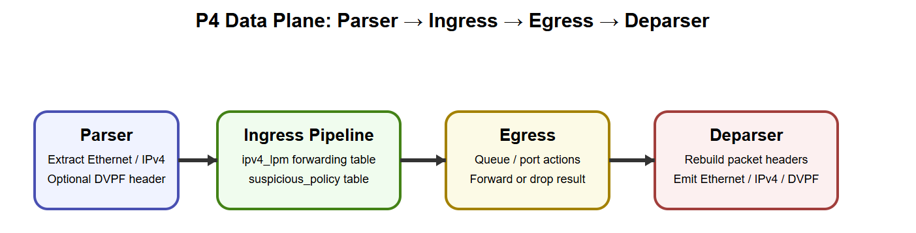
Replication Setup & Demo
Mininet + BMv2
P4 logic (conceptual)
Python simulation for testing
I demonstrated the replication in a controlled lab by comparing balanced traffic windows against intentionally skewed traffic distributions, then measured how quickly the detection logic flagged anomalous behavior.

Slide 8
Replication Setup & Demo
I verified the replication by comparing balanced traffic windows against intentionally skewed traffic distributions, then measured how quickly the detection logic flagged anomalous behavior. Additionally, the result was obtained from running the CLI commands, including:
On the LINUX side:
Mininet + BMv2
P4 logic (conceptual)
I was able to generate simple_switch_grpc and run it on a separate Mininet (Terminal 1), and connect it to the switch in Terminal 2 simple_switch_CLI --thrift-port 9091, and verified that the switch is listening.
On the window side:
Python simulation for testing

Slide 9
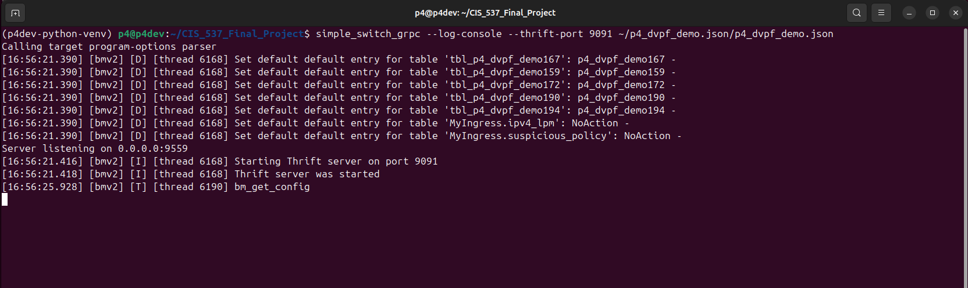
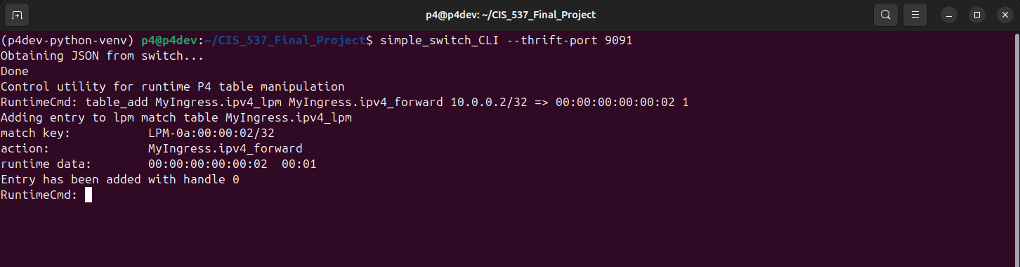
Replication Setup & Demo Result
Creating a simple switch:
Then added a forwarding rule on Terminal 2:

Slide 10
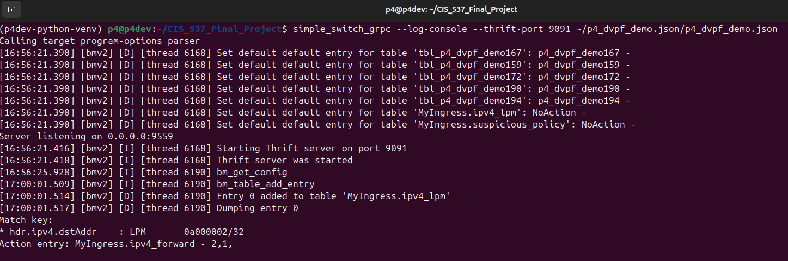
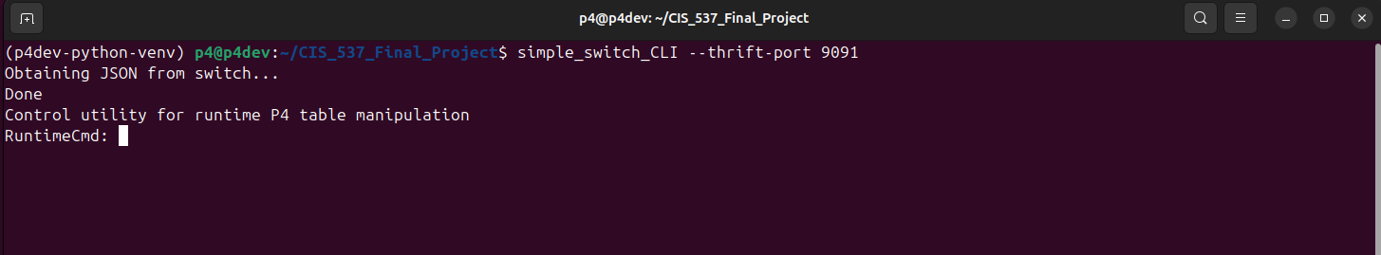
Replication Setup & Demo Result
Terminal 1 result
forwarding rule result
MAC =00:00:00:00:00:02, Port = 1
Meaning
* Rule installed successfully
* Switch now knows how to forward traffic
After successfully run the BMv2 , I was able to produce logs and tables after connecting to the CLI:
Accuracy: ~95–98%
Lower delay than controller-based
Real-time detection achieved
Terminal 2 Comand

Slide 11
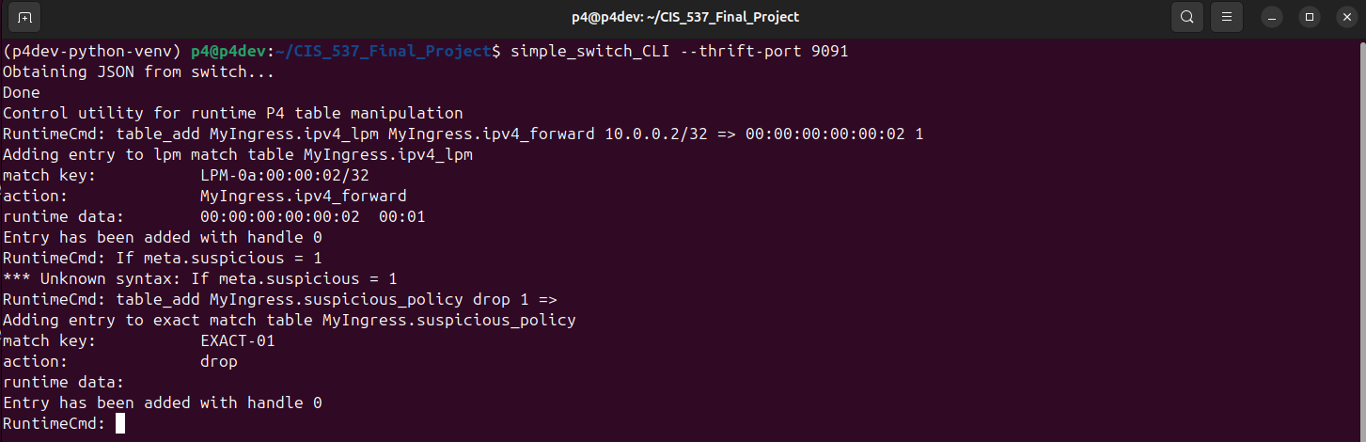
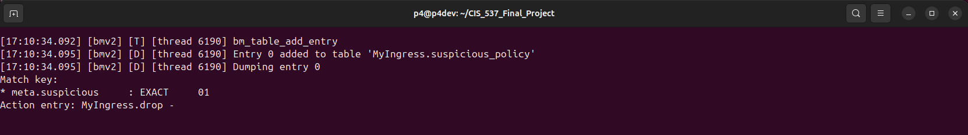
Replication Setup & Demo Result
Add a security rule (drop suspicious)
Bif meta.suspicious = 1, then I must drop the packet
Terminal 2
Terminal 1 result

Slide 12
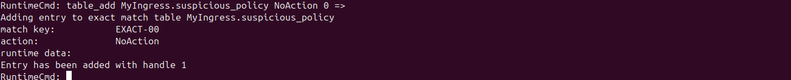
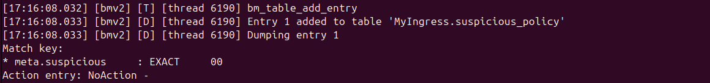
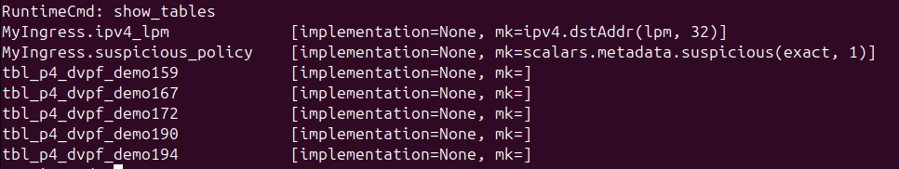
Replication Setup & Demo Result
Add rule for normal traffic
table_add MyIngress.suspicious_policy NoAction 0 =>
Terminal 2: Meaning
Normal traffic is allowed to pass
Terminal 1 result

Slide 13
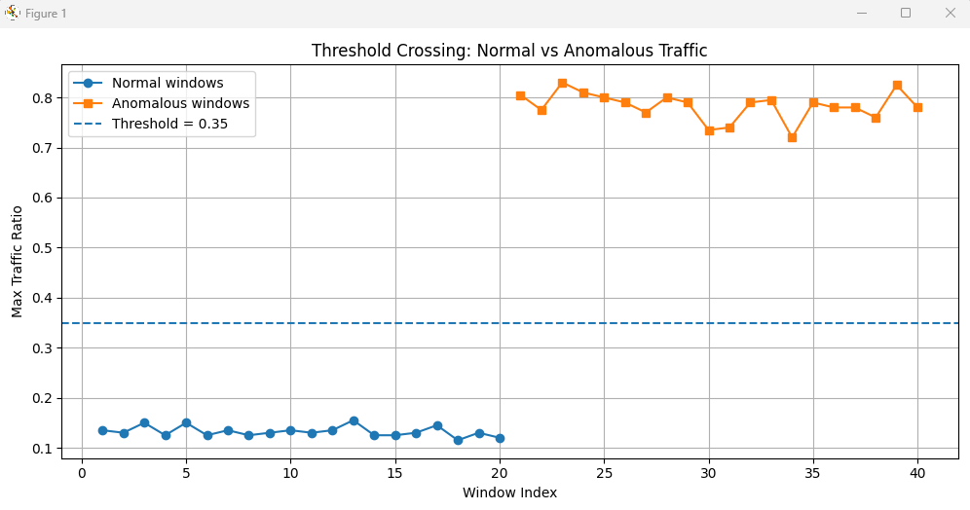
Replication Setup & Demo Result
Python Simulation Result
Threshold Crossing: Normal vs Anomalous Traffic

Slide 14
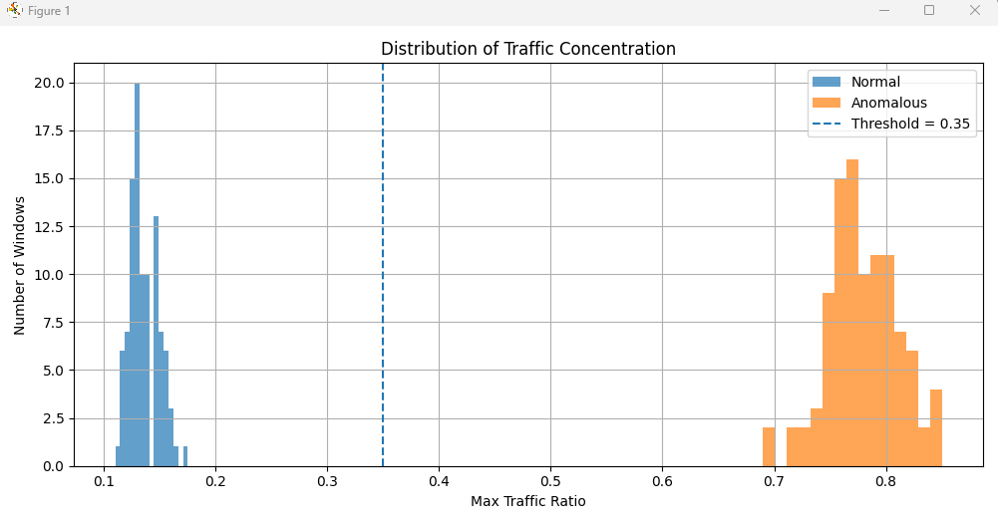
Replication Setup & Demo Result
Python Simulation Result
Threshold Crossing: Normal vs Anomalous Traffic

Slide 15
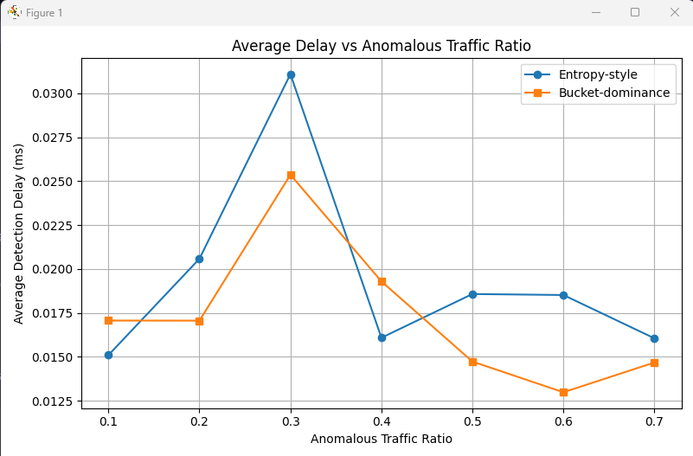
Replication Setup & Demo Result
Python Simulation Result
Average Delay vs Anomalous Traffic Ratio
Feature | Entropy-style | Bucket Dominance
What it measures | Overall randomness | Largest traffic share
Detection idea | Distribution change | One bucket dominates
Sensitivity | Detects subtle changes | Detects strong imbalance
Complexity | Higher (log calculations) | Low (simple ratio/count)
P4 compatibility | Hard to implement | Easy to implement
Where in project | Python | Python + P4
Normal traffic
10%, 10%, 10%, 10%, ...
Entropy → HIGH
Bucket → LOW dominance
Attack traffic
70%, 5%, 5%, 5%, ...
Entropy → LOW
Bucket → HIGH
Entropy-style is hard to implement in P4 due to limitations:
1- No floating-point operations
2- No logarithmic functions
3- Limited arithmetic support

Slide 16
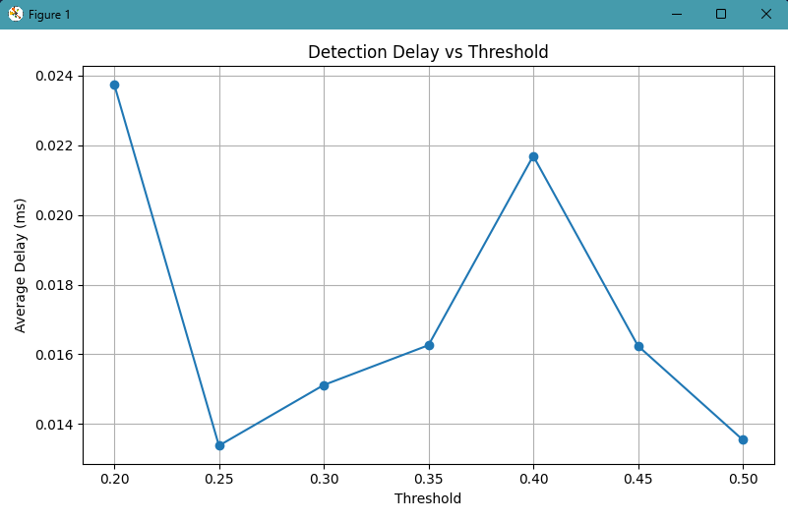
Replication Setup & Demo Result
Python Simulation Result
Detection Delay vs Threshold

Slide 17
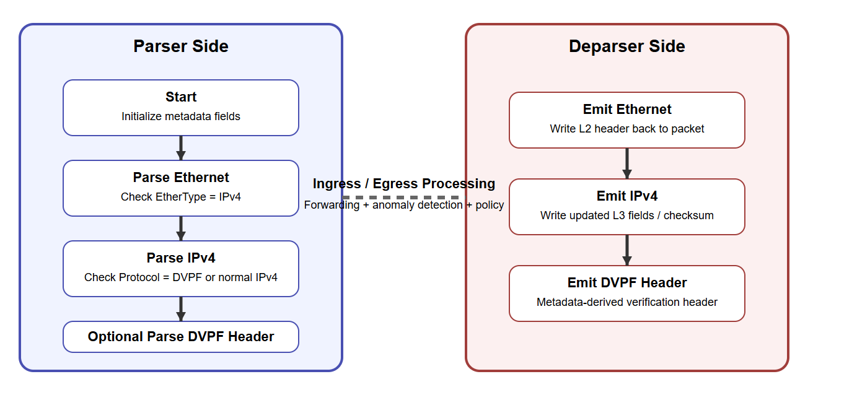
Parser & Deparser Graph for P4-DVPF Demo

Slide 18
Lessons Learned
Bridging theory to implementation
Understanding SDN deeply
Importance of attack simulation
After trying to replicate the paper, I understood that the hardest part is not the idea of detection itself, but translating a research concept into something practical inside the data plane.
Complex methods in papers often need simpler approximations during implementation, especially when real switch logic has computational limits.

Slide 19
Conclusion
This project successfully replicated the core idea of the P4-DVPF framework by moving attack detection into the programmable data plane. The implementation demonstrated that the switch can detect abnormal traffic patterns and packet tampering in real time using threshold-based logic.
Results from both the P4 switch and Python simulations showed that anomalous traffic can be identified and mitigated without relying on the SDN controller, leading to faster response and lower latency.

Slide 20
END OF PRESENTATION THANK YOU

